Slide 1


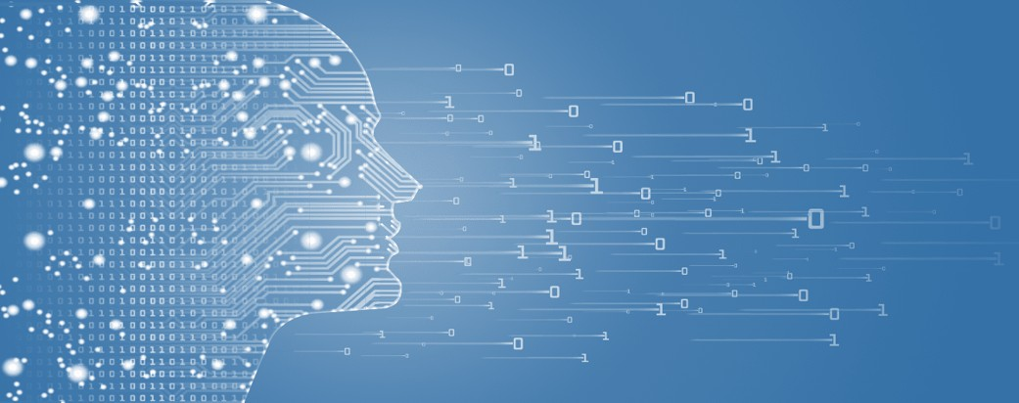
Microsoft Data Engineer Project
CAI1_AIS4_S7e
)Customer Data Management and Analysis(

Slide 2
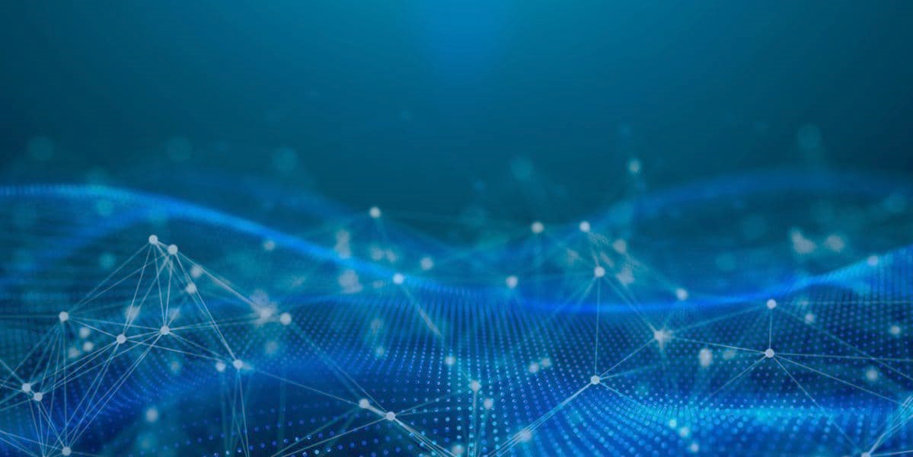
content
1
Team members
2
introduction
4
Week 2
5
Week 3
6
Week 4
3
Week 1
7
conclusion

Slide 3

Team members
Name | ID
ايات احمد محمد احمد | 21050066
شهد احمد ابراهيم احمد | 21017428
مريم محمد علي محمد | 21045055
ريناد هيثم عثمان متولي | 21042779
سلمى اشرف عبدالحميد | 21014734
ريم صلاح السعيد شهاب | 21015311

Slide 4
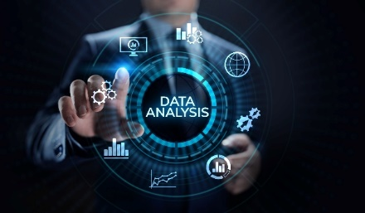
Introduction
Customer Data Management and Analysis
In the era of digital transformation, businesses must efficiently manage and analyze vast amounts of customer data to drive insights, improve services, and stay competitive. This project focuses on creating a robust system for Customer Data Management and Analysis, aiming to streamline customer information, transactions, and interactions.

Slide 5
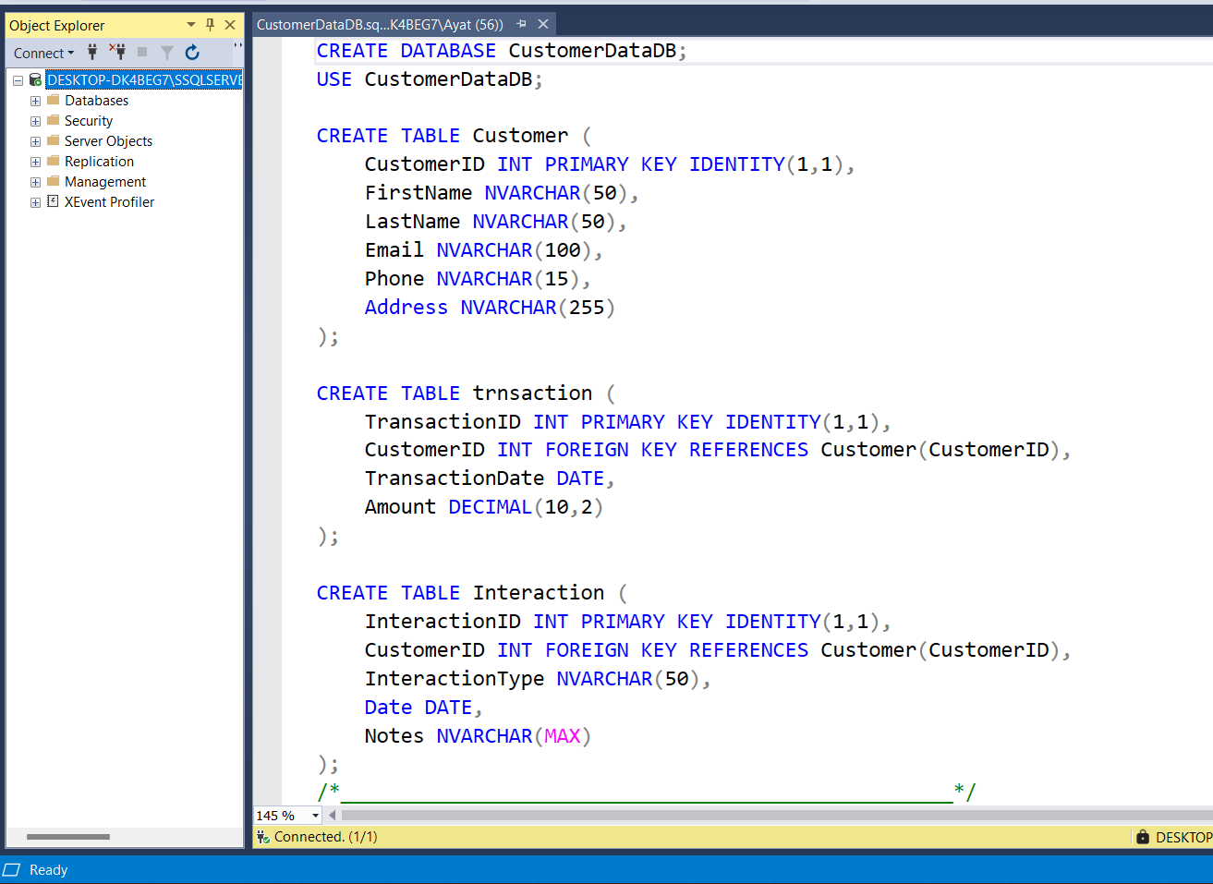
Week 1
1.1 Database creation

Slide 6
Customer
Transaction
Interaction
1.2
Data insertion

Slide 7
Data extraction
Updating data
Data analysis
1.3
SQL Queries

Slide 8
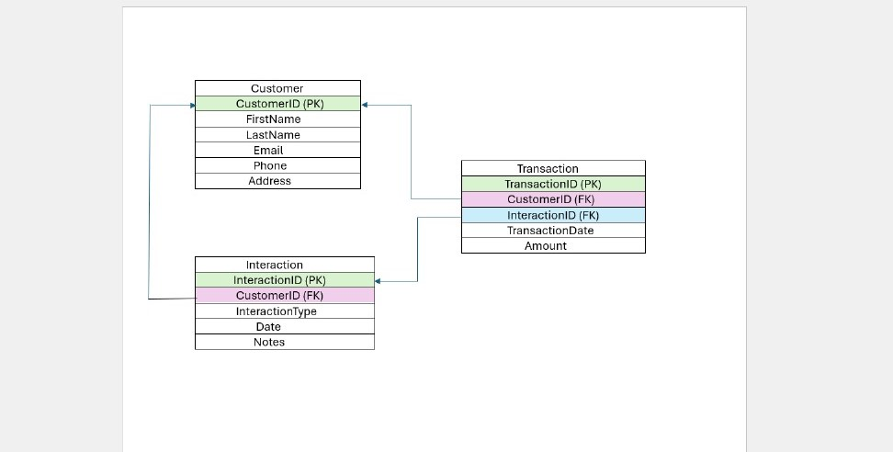
Week 2
Star schema

Slide 9
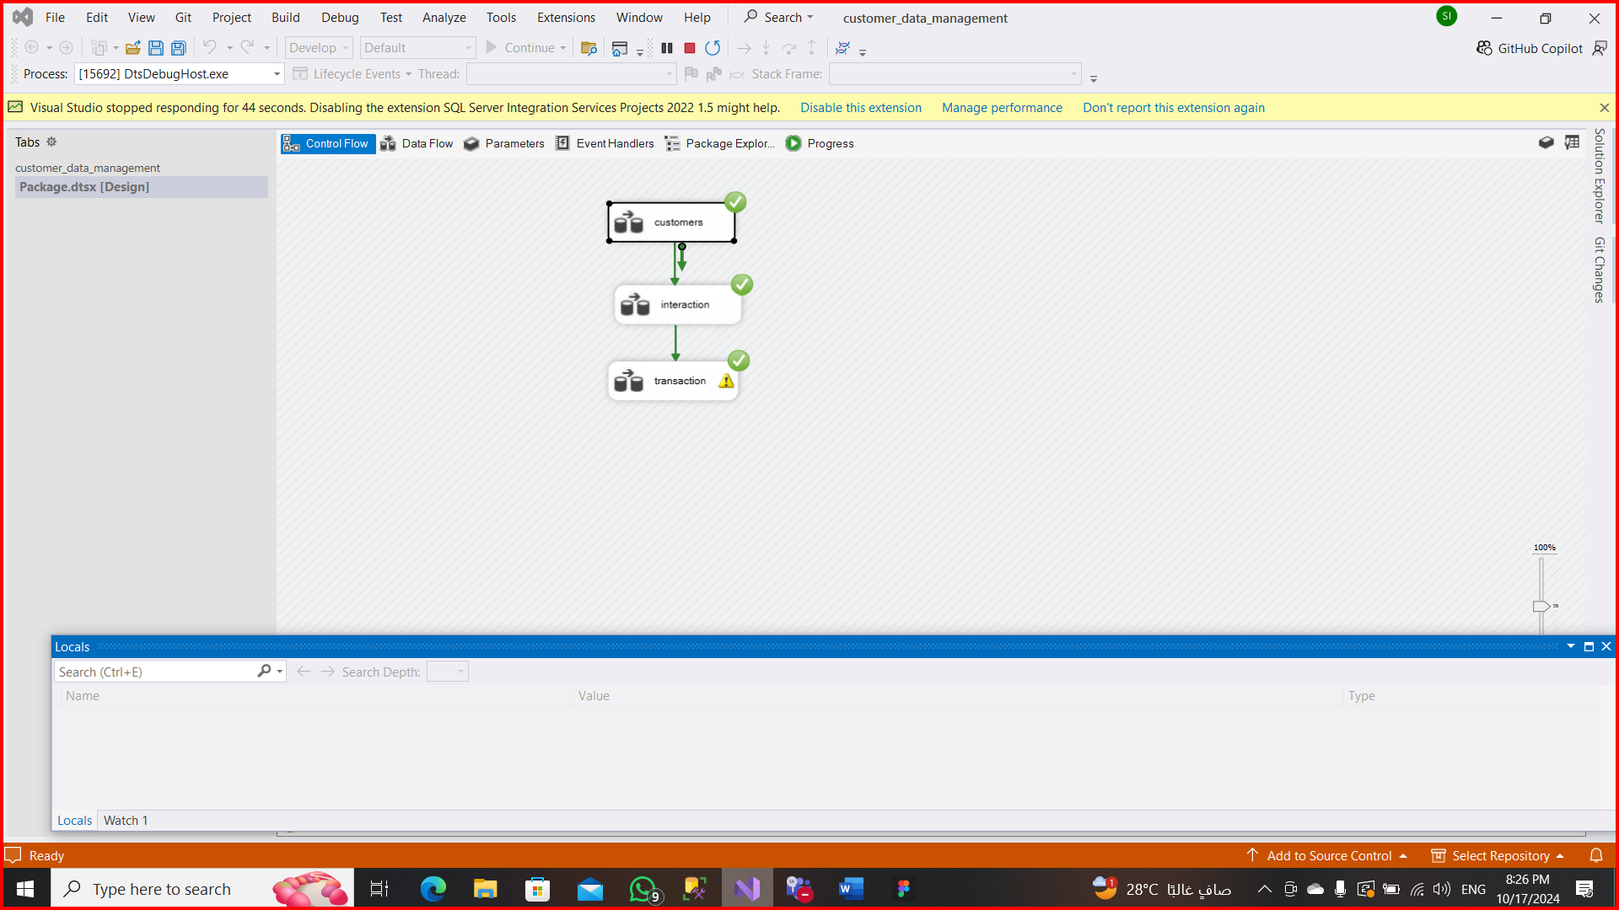
2.1
Data Warehouse Implementation

Slide 10
customer
2.1.1
ETL

Slide 11
interaction

Slide 12
transaction

Slide 13
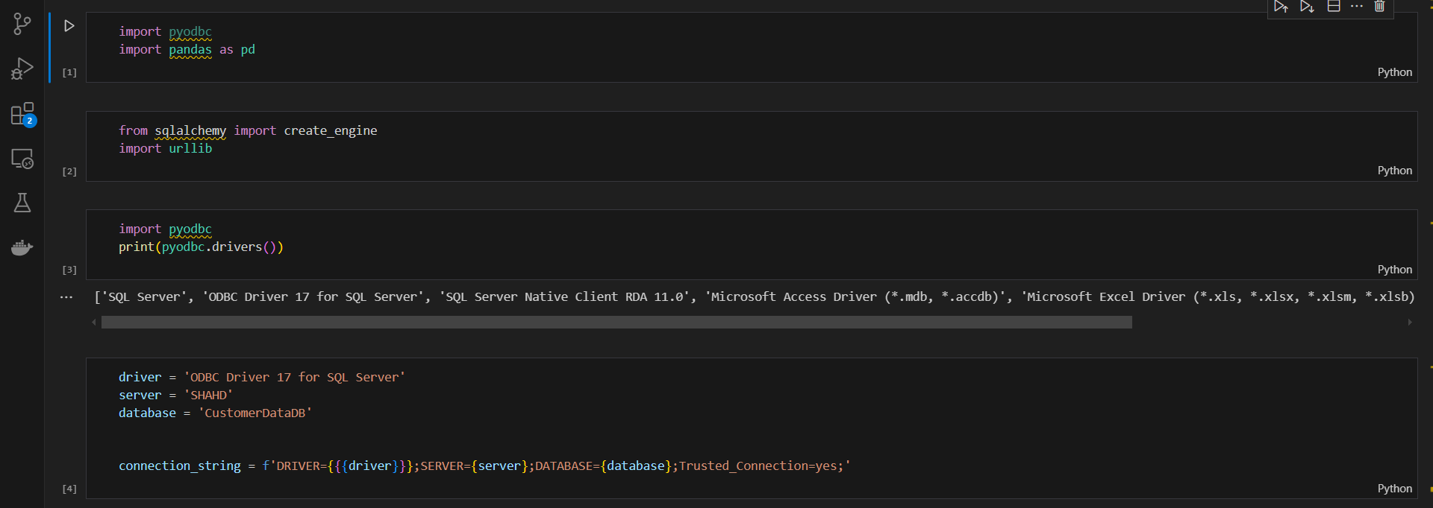
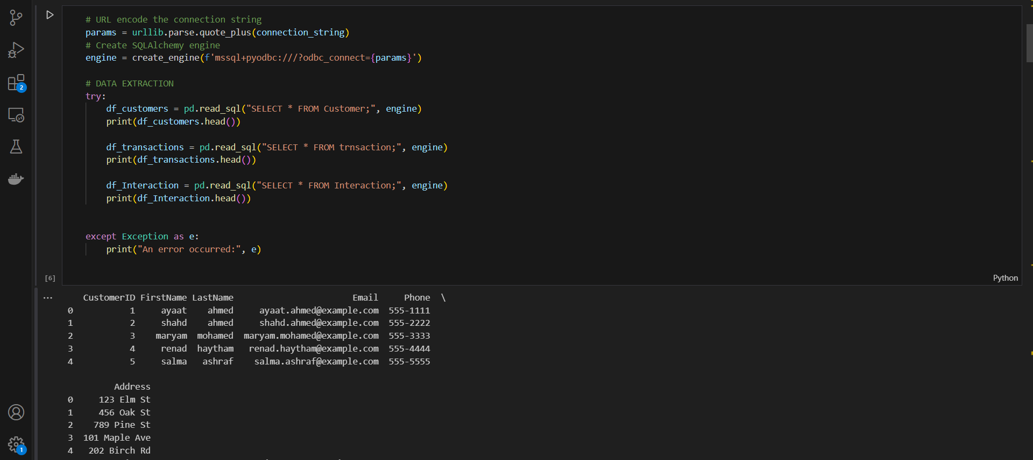
2.2
Python Programming

Slide 14
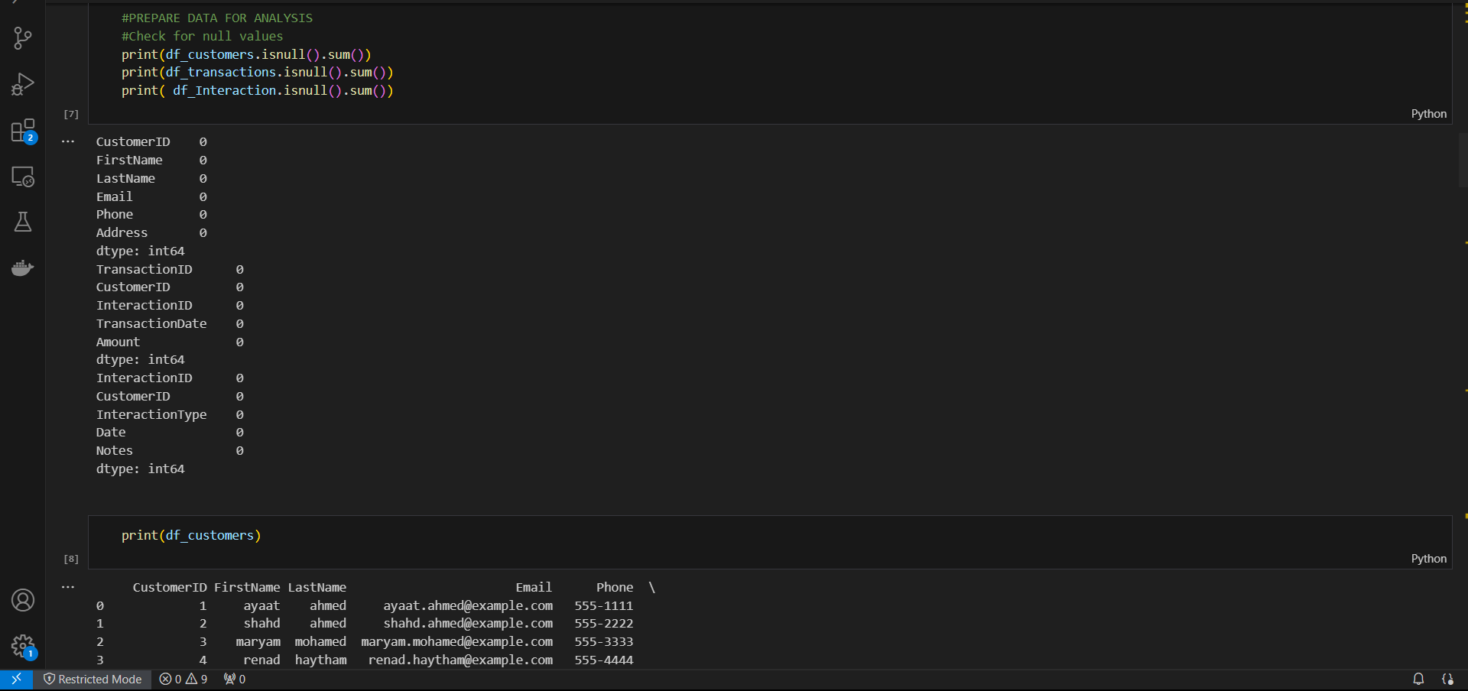
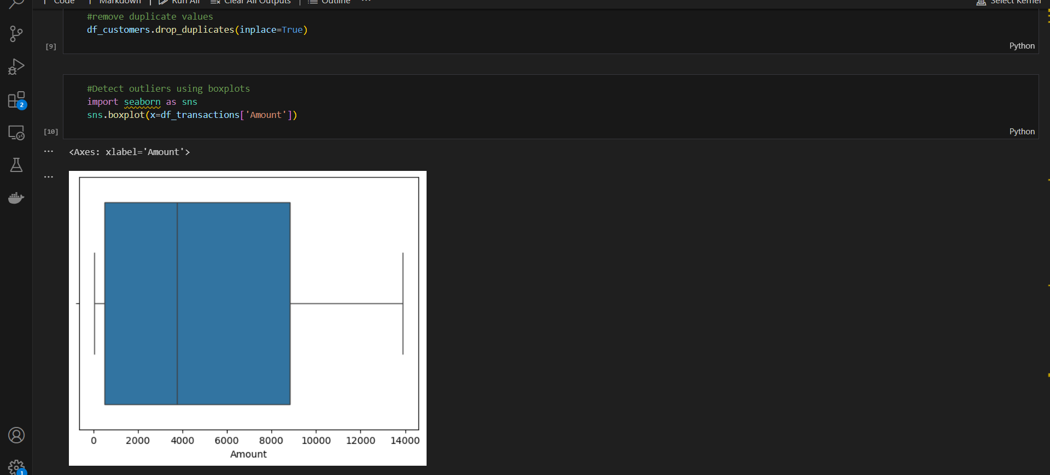

Slide 15
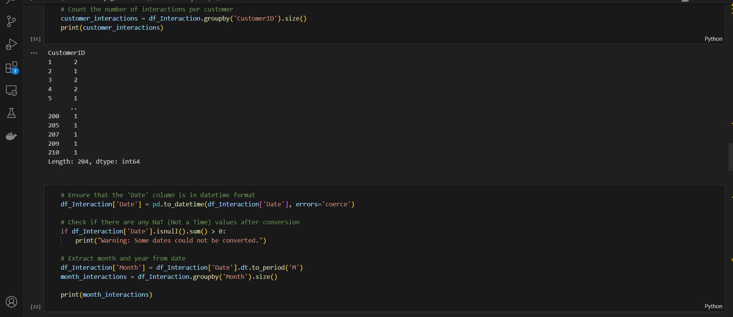
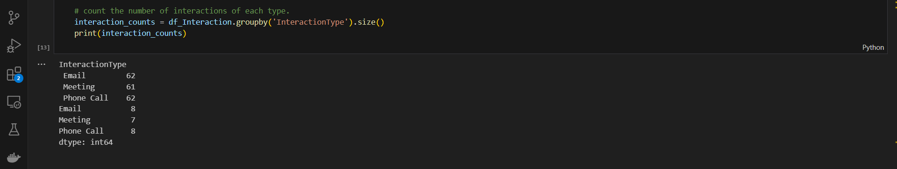

Slide 16
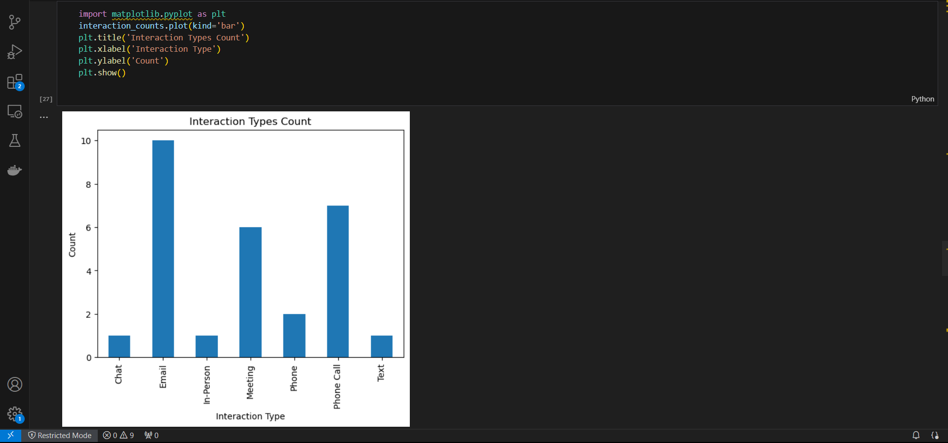
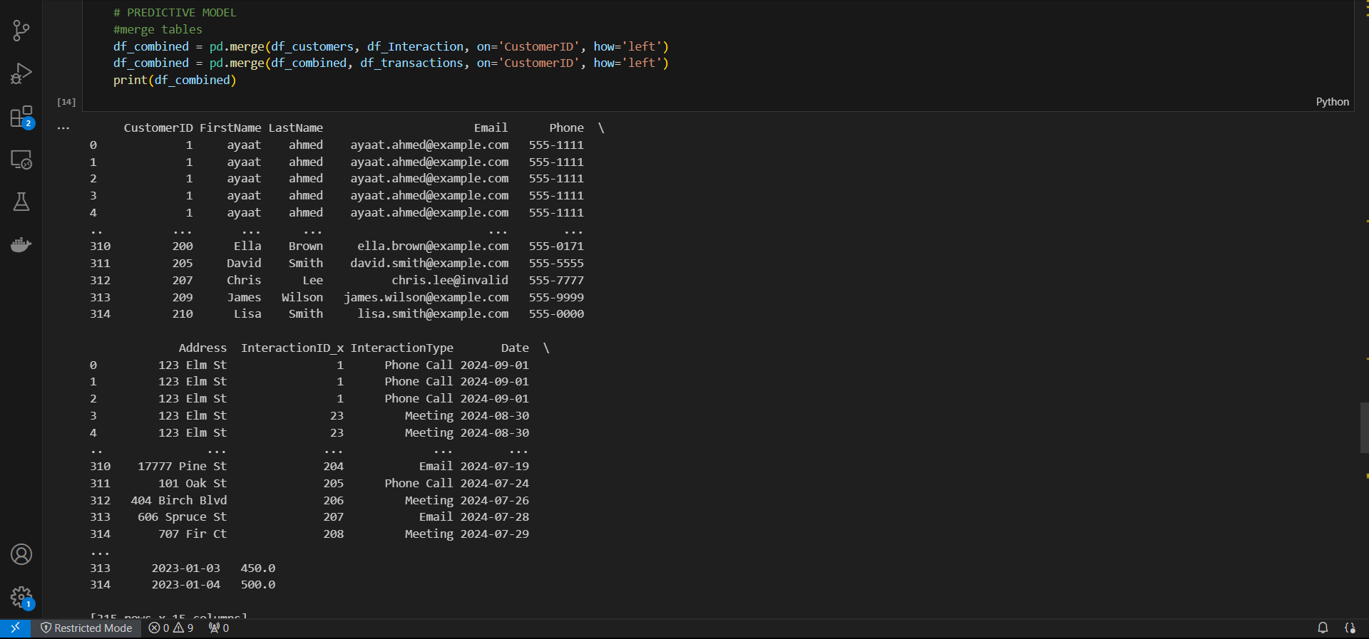

Slide 17
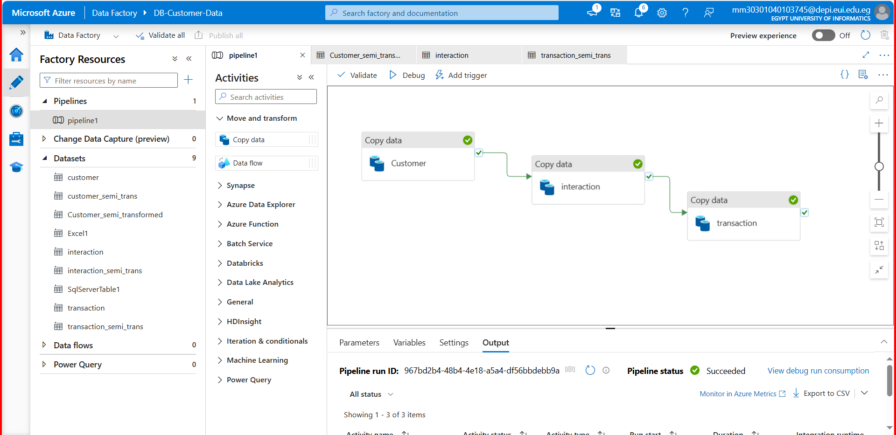
Week 3
3.1
Azure Integration

Slide 18
Data loaded
Storage account

Slide 19
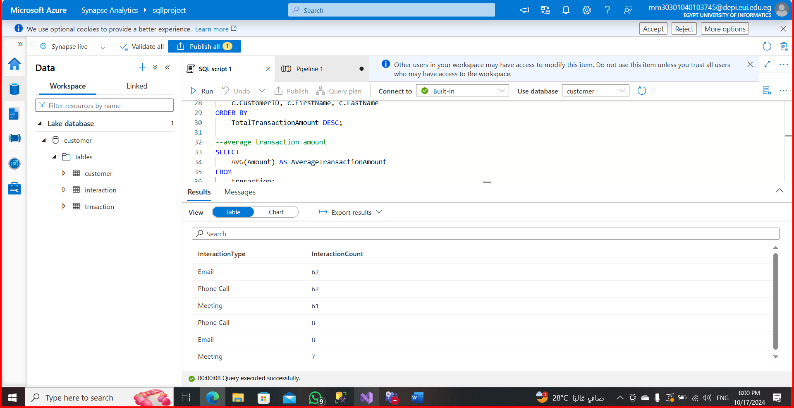
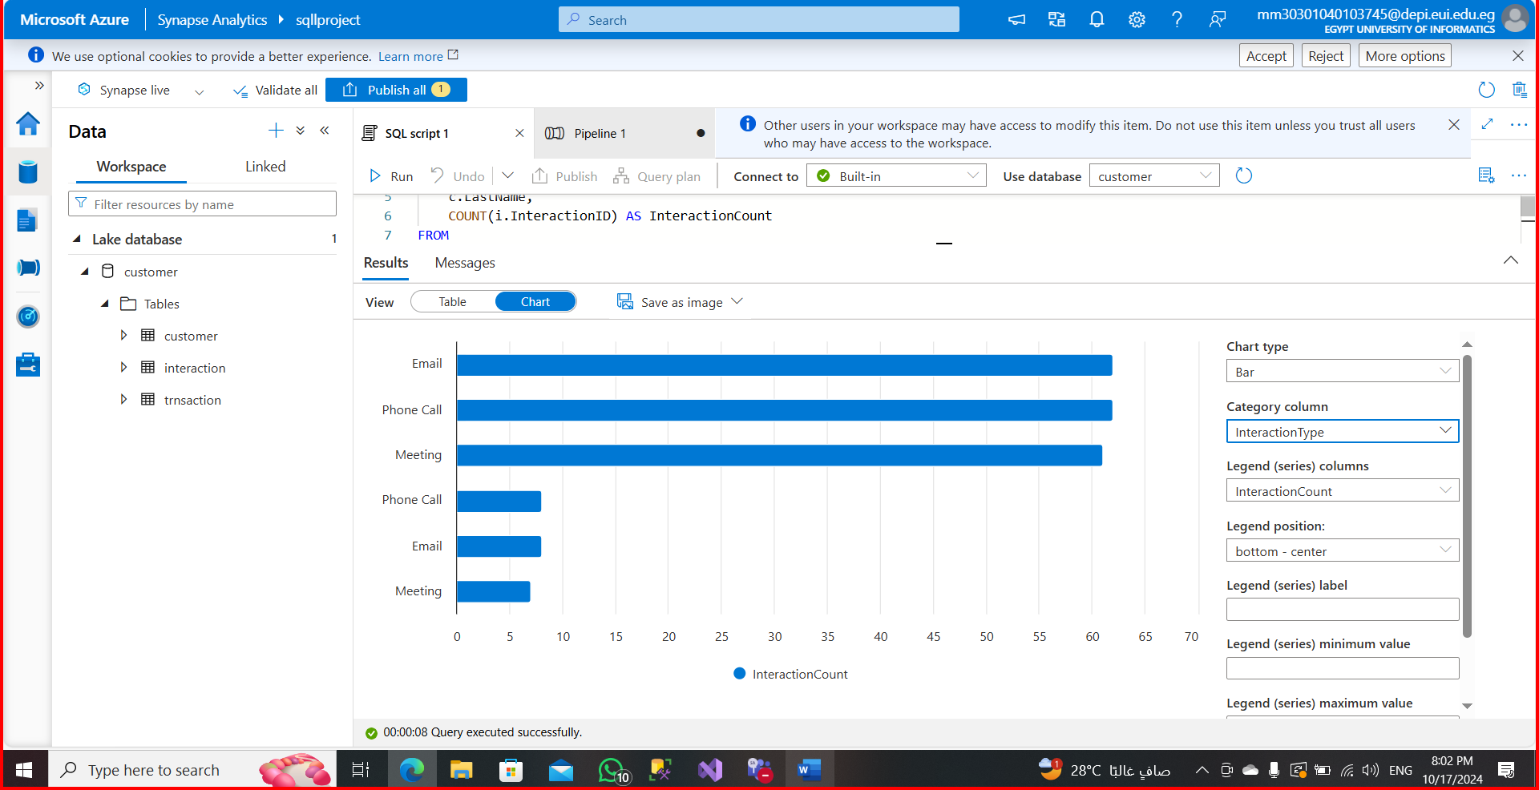
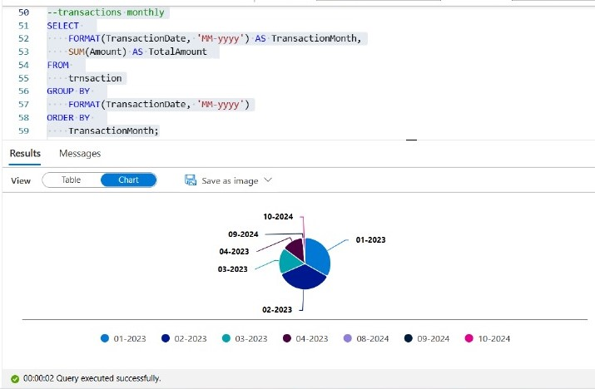
Analyze data using
synapse analytics
charts

Slide 20
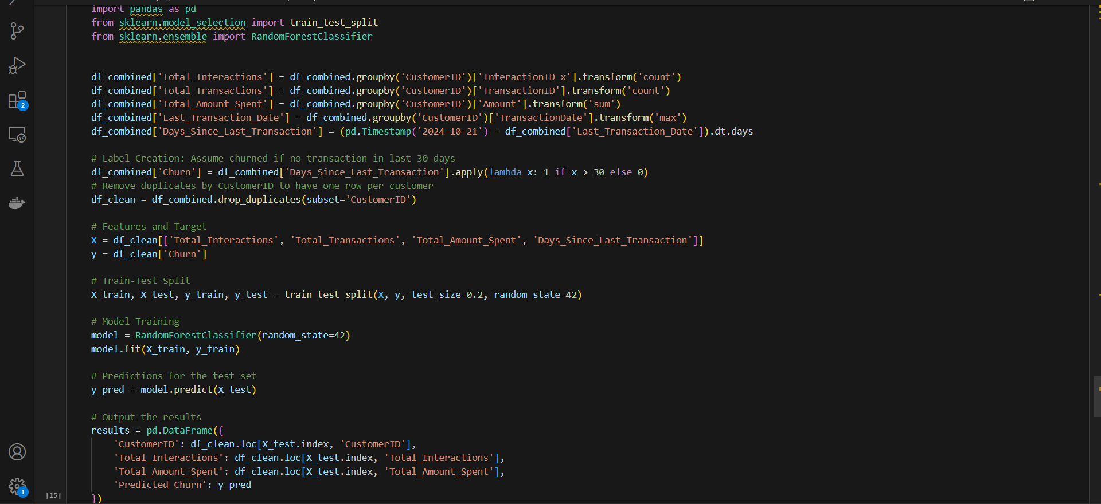
Week 4
4.1
Machine learning model
Classification using a RandomForestClassifier to predict whether a customer will churn or not, based on their transaction history and other interactions

Slide 21
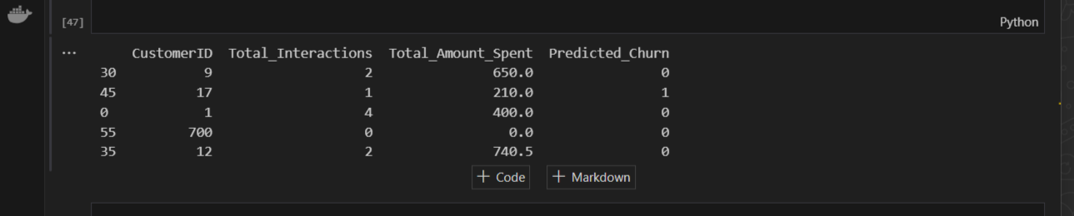
Machine learning model output:

Slide 22
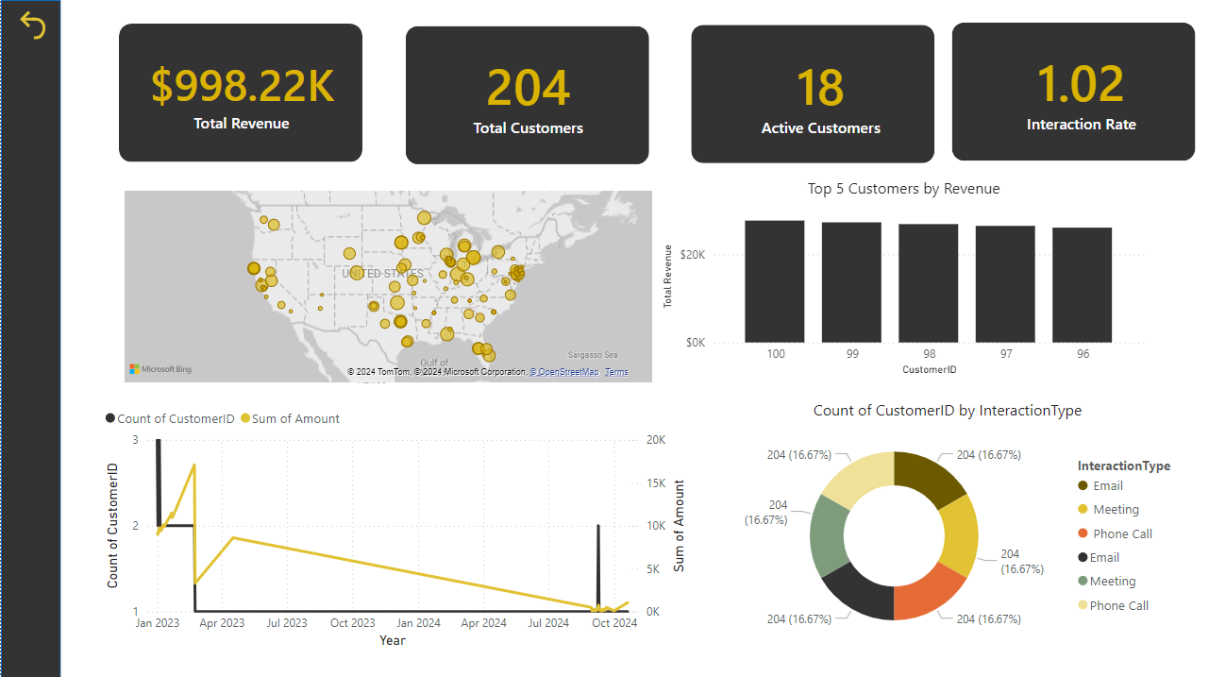
4.2
visualization

Slide 23
conclusion
We hope this walkthrough has provided you with valuable insights into the process and the thoughtful approach we’ve taken to achieve our goals
A special thank you to Eng. Sherif Abd Elaziz for his invaluable guidance and efforts throughout this project. His expertise and dedication have greatly contributed to our progress and success.
Thank you all for your time, attention, and support. We are excited about the potential impact of this project and look forward to any questions or feedback you may have.

Slide 24

Thank you

